Slide 1
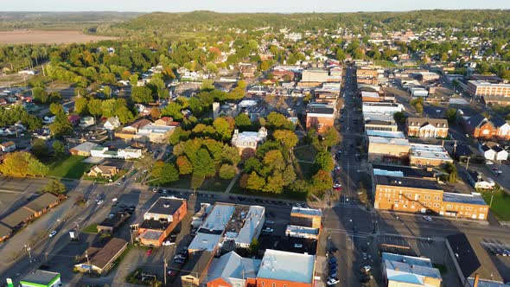
Vacant Property Prediction and Pattern Analysis in Syracuse
Group 2-8
Eric Lee, Ari Fazlija, Rajat Rohilla, RIshikesh Thakker
EL

Slide 2

Project Overview
Content:
Objective: Predict vacant properties and identify patterns contributing to vacancy.
Key Questions:
1. Can we predict which properties are likely to become vacant?
2.What patterns or characteristics contribute to vacancy?
Data Sources: Syracuse property data, violation reports, and crime data. (Open Data Syracuse)
Methods: Clustering analysis for pattern detection, Random Forest for prediction.

Slide 3
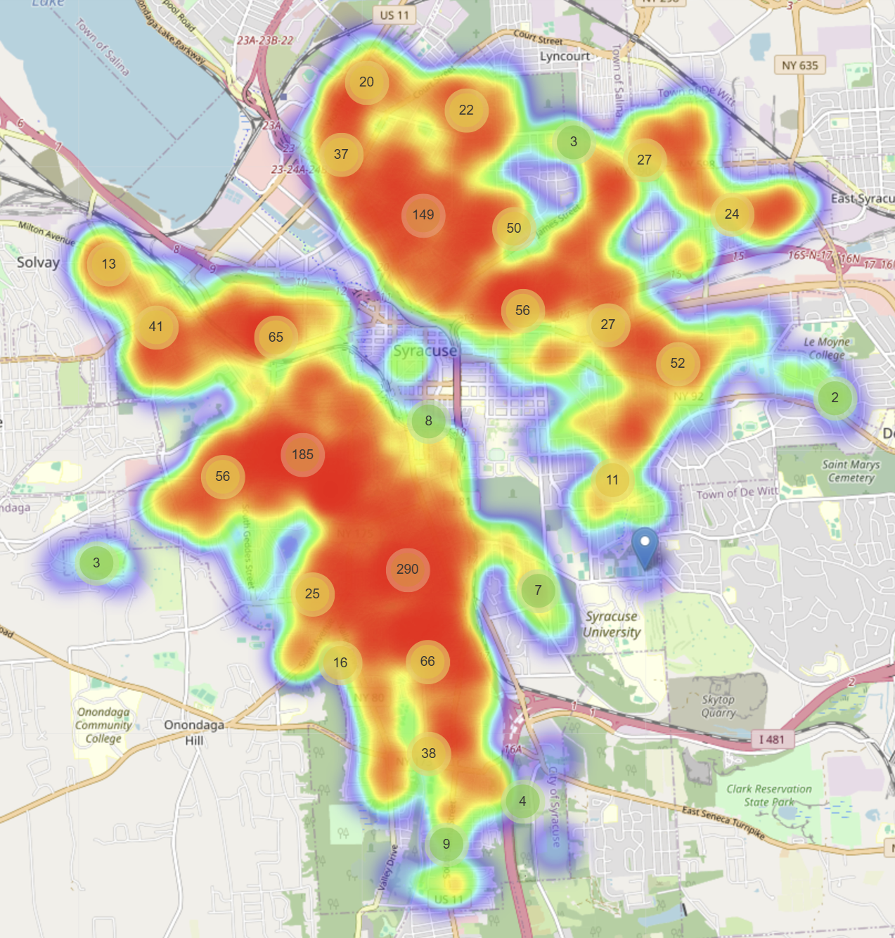
Vacancy Problem
Syracuse has been facing an ongoing issue of property vacancies, which is apparent in a plethora of neighborhoods across the city as depicted by the heat map to the right.
Key Issues
Safety Hazards – increased risks of structural mismanagement
Inhabitant decline – vacant properties hinder neighborhoods ability to garner new inhabitants,
Economic Burden – increased financial responsibility to the local government affecting tax revenues and homeowners
Our Goal:
Predict future vacancies, so that the city of Syracuse can allocate resources more effectively
Identify high risk areas, so that local government can step in to safeguard said areas.
In this project we will be using predictive analytics as an initiative to provide actionable insights regarding vacant housing in the City of Syracuse.

Slide 4
Dataset Description
Data | Description
Code Violations | Information about code violations; 24 Columns, 13763 rows
Vacant property Data | List of properties vacated; 17 columns, 1335 rows
Crime Data | Crime incidents reported to the Syracuse Police Department; 11 columns, 4638 rows
Syracuse Parcel Map | Property Tax identifier; 62 columns, 41,096 rows
Description
To accurately predict property vacancy and uncover meaningful patterns, we were able to integrate these data sets through aligning location-based data such as zip codes and addresses. This allows us to assess the relationship of various attributes such as crime, vacancy, code violations, and property aspects, to build a solid foundation for our predictive models.

Slide 5
Prediction and Inference Goals
1
Identify Vacancy Patterns
2
Predicting Vacancy
3
Enable Proactive Management
Use Random Forest modeling to predict property vacancy (vacant, non-vacant), based on key features such as code violations, existing vacancy, and crime.
Use clustering techniques(K-means) to uncover insights and relationships associated with vacant and non-vacant properties.
Combine regression and clustering insights to identify high-risk properties and support targeted interventions.

Slide 6
Clustering Models
Motivation
Data Scaling for Consistency: We scaled features using StandardScaler to ensure all variables have equal importance during clustering, as K-Means is sensitive to feature magnitudes.
K-Means Clustering: We used K-Means to group properties into clusters based on similarities in features like code violations, land value, and crime data, helping identify patterns in vacant and non-vacant properties.
Cluster Evaluation: We calculated the Silhouette Score to assess how well our clusters were formed, ensuring they are meaningful and well-separated.
Balancing the Dataset: To improve clustering results, we oversampled vacant properties, creating a balanced dataset that allowed K-Means to treat vacant and non-vacant properties equally.
Dimensionality Reduction with PCA: We applied PCA to reduce the dataset to two features, simplifying visualization and enhancing the clustering process.
Visualization and Insights: We visualized clusters and their centroids to clearly see property groupings, making it easier to identify areas prone to vacancy and prioritize intervention strategies.

Slide 7
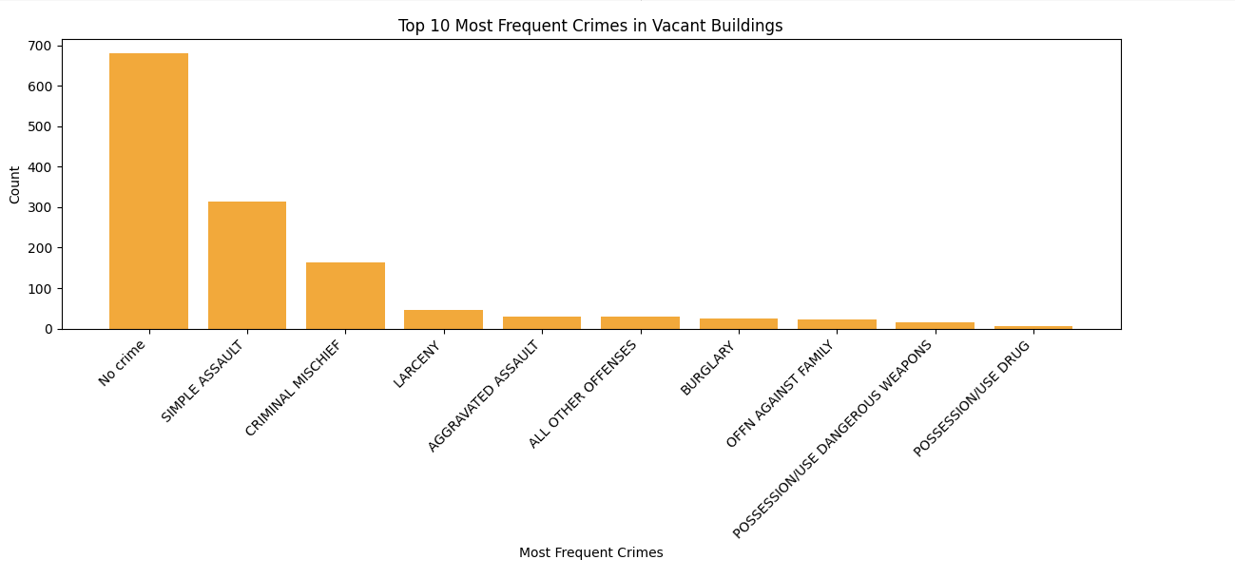
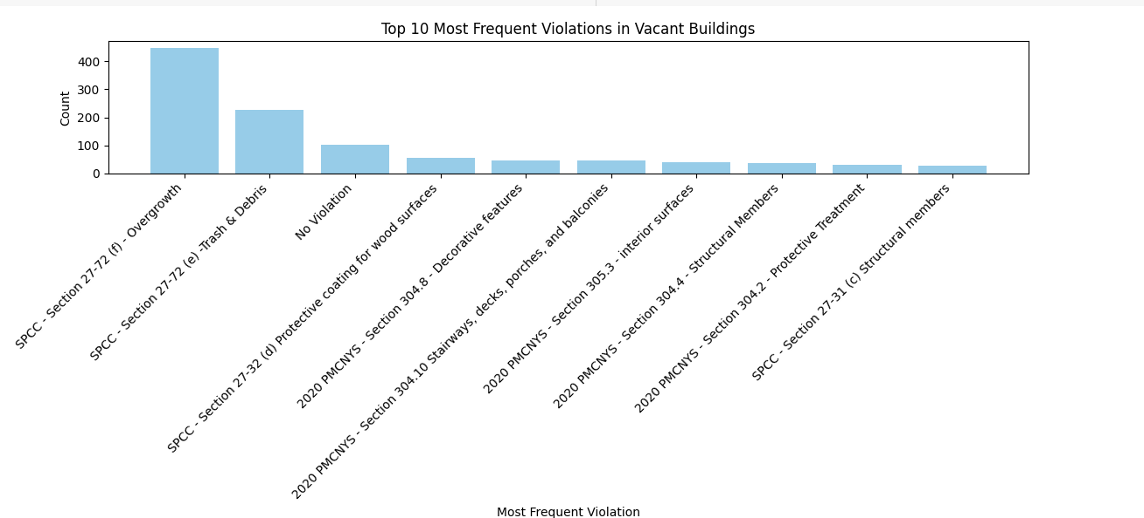
Data Exploration

Slide 8
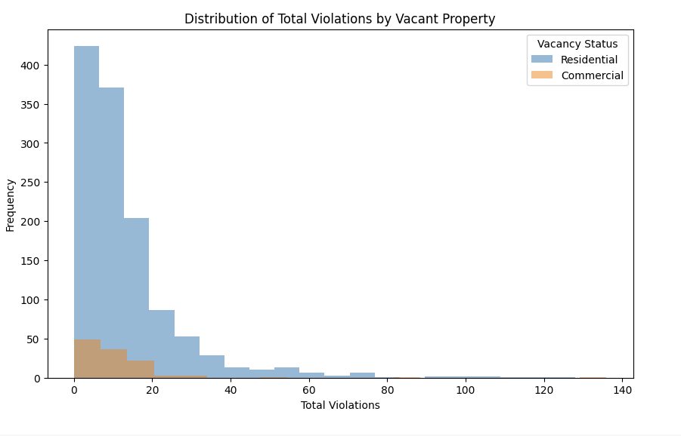
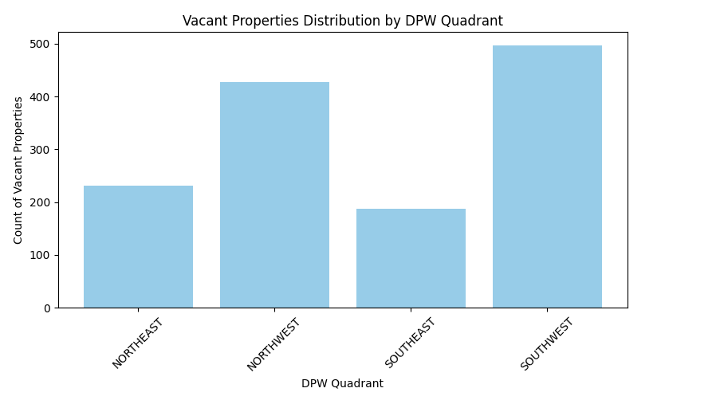
Data Exploration

Slide 9
Prediction Model
Motivation
To address the problem of classifying vacant and non-vacant properties, a robust machine learning pipeline was developed using PySpark. The dataset was processed to include a class_weight column, which assigns higher weights to the minority class (vacant properties) to handle class imbalance. The dataset was split into 80% training and 20% testing subsets using a random seed for reproducibility. Chi-square feature selection was employed to identify statistically significant features, which were then standardized using a StandardScaler to improve model performance.
A Random Forest classifier was trained on the processed dataset using the selected and scaled features, leveraging the class weights to account for the imbalance. The model achieved an AUC (Area Under the Curve) of 0.89 on the test set, with a precision of 0.97, a recall of 0.81, and an F1-score of 0.87. Despite these metrics, further analysis was conducted by oversampling the minority class (vacant properties) to balance the dataset more effectively. Oversampling increased the number of vacant property samples to 5,358 while maintaining 39,752 non-vacant samples. After re-training the Random Forest model on the balanced dataset, the test set performance was evaluated again, yielding an AUC of 0.87, a precision of 0.78, a recall of 0.88, and an F1-score of 0.83. The precision-recall AUC, however, was 0.49, indicating room for improvement in distinguishing between the two classes under certain conditions.
The confusion matrix revealed that while the model accurately predicted non-vacant properties (7,861 correctly classified), it missed 1,037 vacant properties. This analysis highlights both the strengths and limitations of the current approach. While the classifier is effective overall, improving its ability to detect vacant properties without compromising precision is a potential area for future work.

Slide 10



Problems Encountered
Imbalanced Data
1
Non-vacant properties were significantly outnumbered by vacant ones, making prediction challenging
Data Integration Challenges
2
Variations in provided information and mismatches across datasets complicated the merging process
Over-sampling Risks
3
Over-sampling techniques for balancing data introduced potential risks of overfitting

Slide 11
Summary of Results
Random Forest Regression Model to Predict Vacant Buildings
1
AUC: 0.89 - Effectively predicts vacant and non-vacant properties
PR-AUC: 0.49 - Handles class imbalance but precision-recall trade-off can improve
K-Means Clustering to Identify Vacancy Patterns
2
Silhouette Score: 0.51 – Highlights moderate clustering quality, revealing distinct patterns in vacancy distribution
Prediction of High Vacancy Probability by Address
3
Identified unit-specific addresses with the highest likelihood of becoming vacant for targeted management

Slide 12
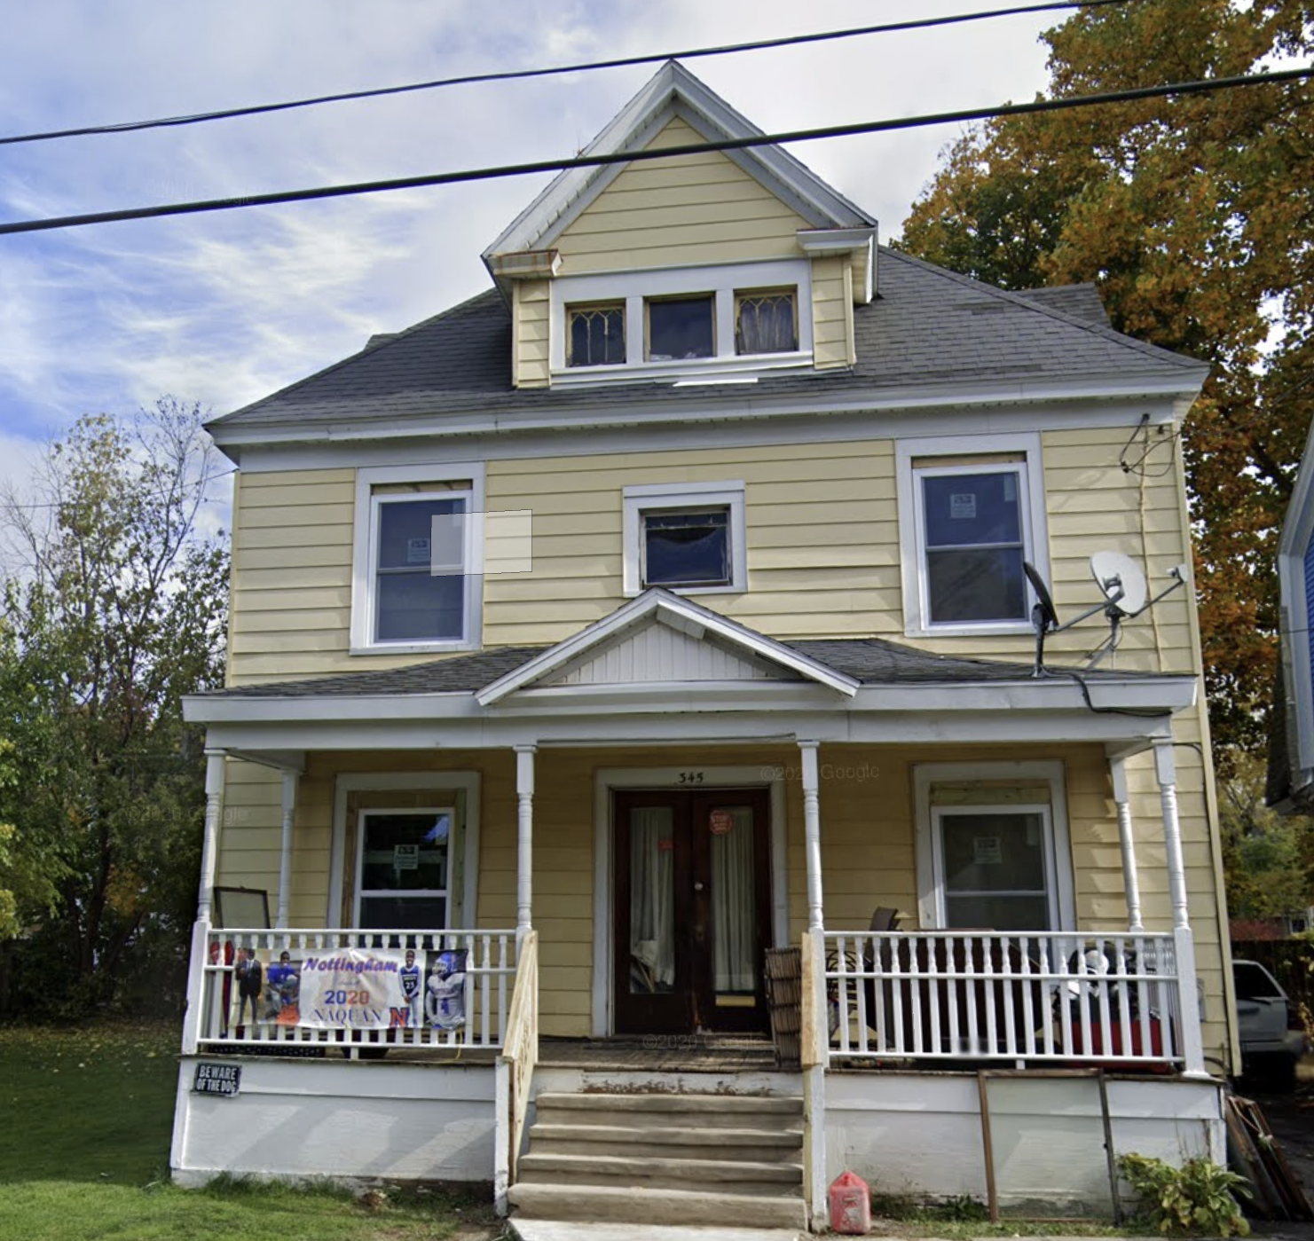
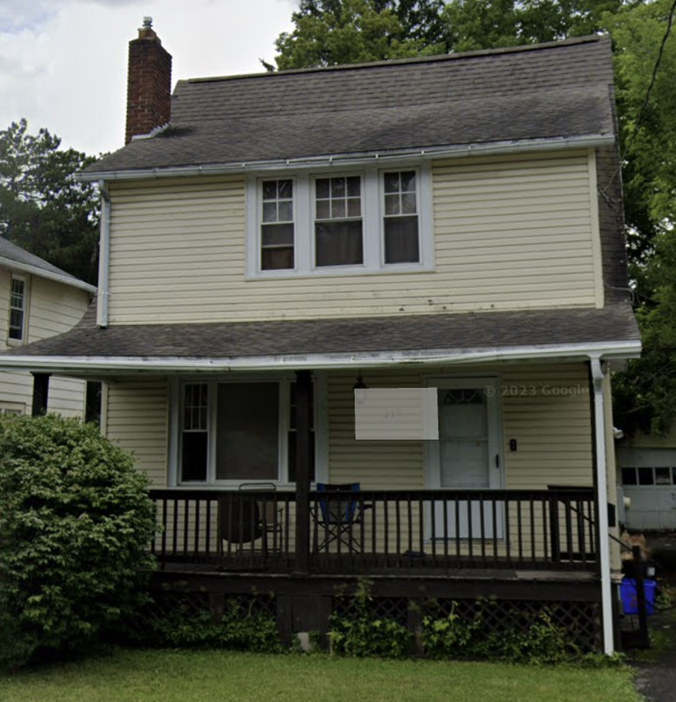
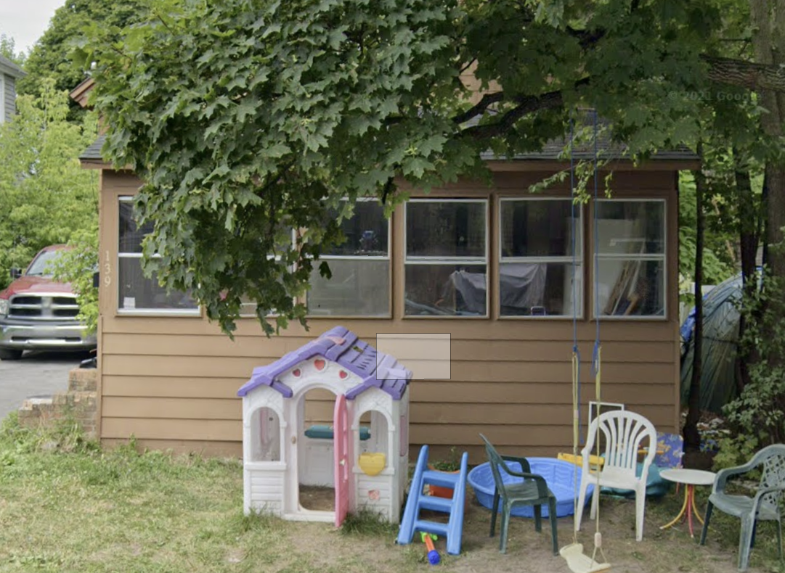
Conclusion
Vacant properties have more violations and slightly more residential units
Vacant properties have higher total and land assessed values
These patterns suggest that larger or more valuable properties may face challenges in maintenance, leading to vacancy
Top 3 Predicted High-Vacancy Properties
345 Baker Ave
218 Ferndale Dr
139 Delong Ave

Slide 13
Future Work
1
Improving Imbalanced
Data Handling
2
Improving Geographic
Visualization
3
Leveraging Richer Data for
Improved Accuracy
Implement advanced sampling techniques and methods to better address class imbalance and improve vacant property predictions
Integrate geographic data to enable visualization of predictions on maps, addressing the current limitation of missing location information in the dataset
Incorporate additional factors such as regional income levels and Transportation Accessibility to refine predictions and uncover deeper insights into the causes of property vacancies

